Slide 1

BANK ANALYTICS
P1009
By Group-6
AKSHAY HIVARKAR
DIVYA T
MANJUSHA SATISH AKOLKAR
SRI GANESH KG

Slide 2
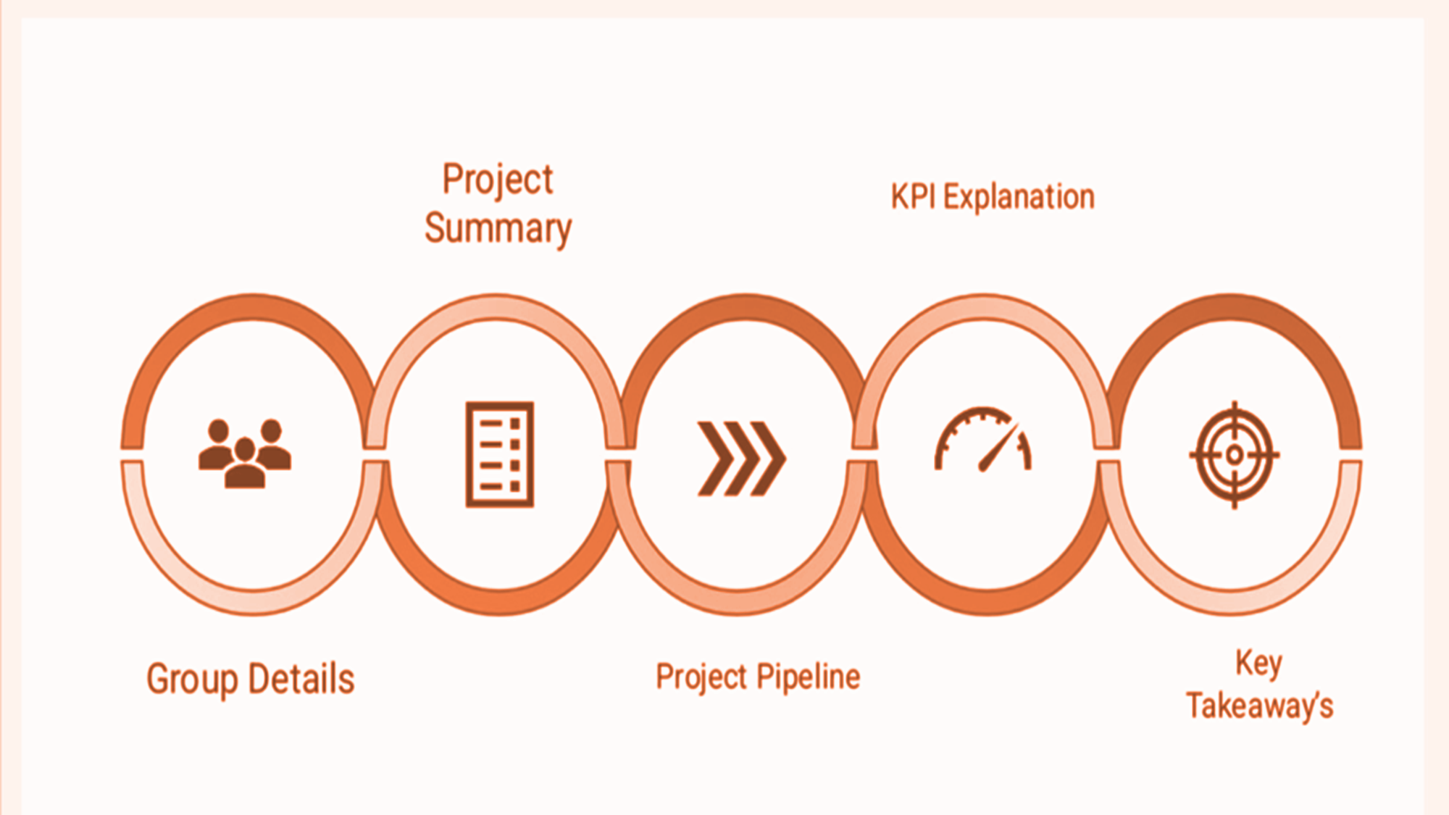
AGENDA

Slide 3




TOOLS
Excel
Tableau
PROJECT MANAGEMENT TOOLS
Power BI
My SQL

Slide 4
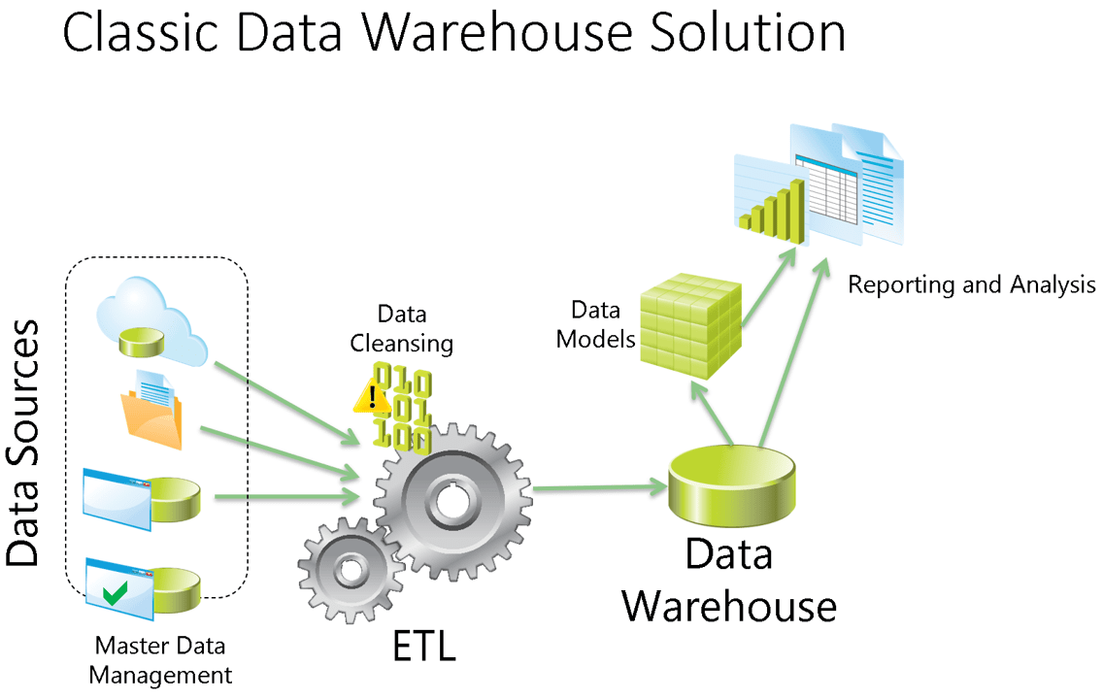
WORKFLOW

Slide 5
INTRODUCTION
This project involved building Six professional dashboards to give a clear and interactive view of the bank’s performance:
Bank Analytics Dashboard:
Focuses on loan disbursements, collections, interest income, delinquencies, and branch performance.
Bank Debit & Credit Dashboard:
Highlights debit and credit activity trends, account balances, and suspicious transactions
We used MS Excel Power Query and Pivot Tables for data cleaning, transformation, and initial analysis. Additionally, we utilized Power BI and Tableau to create interactive dashboards using advanced features such as DAX functions, calculated fields, and dynamic visuals. These tools helped us in building insightful, real-time dashboards that provided clear performance indicators for better decision-making.

Slide 6

KPI Explanation and Key Insights

Slide 7
BANK ANALYTICS AND DASHBOARD
Key KPIs:
Total Loans: 65.54K
Loan Funded: ₹732.7K
Total Collection: ₹815.67M
Total Interest Earned: ₹155.29M
Not-Verified Loans: ₹42.74K
Default Loan Rate: 1.56%
Delinquent Loan Rate: 10.84% – High delinquency, repayment risk
📌 Insights:
Disbursement Trend:
Disbursements grew from FY 2017 to peak in FY 2019 (₹427M).
It got dropped in FY 2020 (₹63M)
State-Wise Loan Distribution:
Uttar Pradesh has the highest loan distribution (₹138M), followed by Punjab (₹119M).
Loan Status-Wise Distribution:
Majority are Active (₹412M) and Fully Paid (₹190M).
Grade-Wise Loan:
Most loans are in Grade B (₹134M) and Grade C (₹87M).
Product Group-Wise Loan:
Home Loans dominate with ₹278M — bank’s most popular product.
Age Group-Wise Loan:
26–35 age group has highest loan volume (₹261M), followed by 36–45.

Slide 8
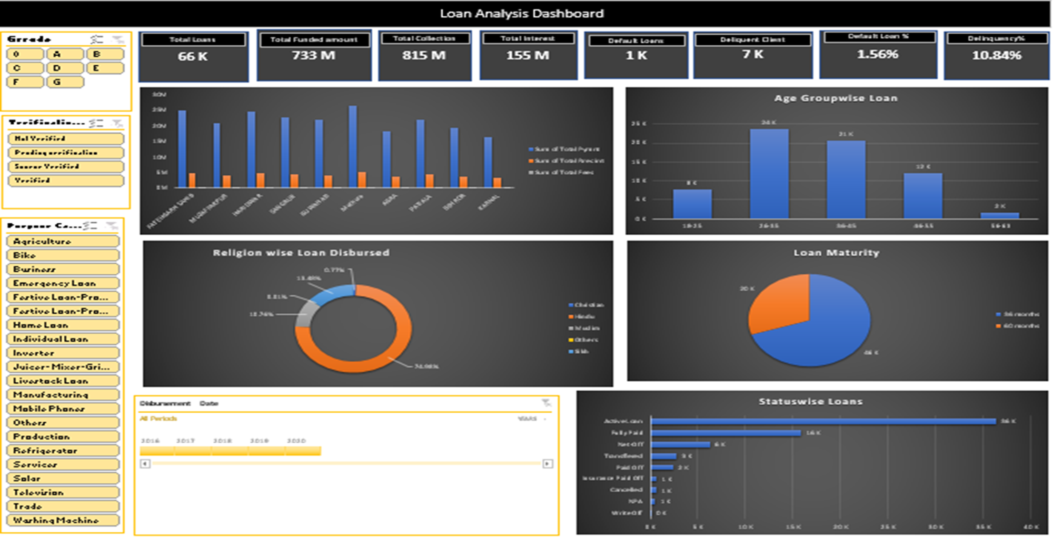
EXCEL DASHBOARD

Slide 9
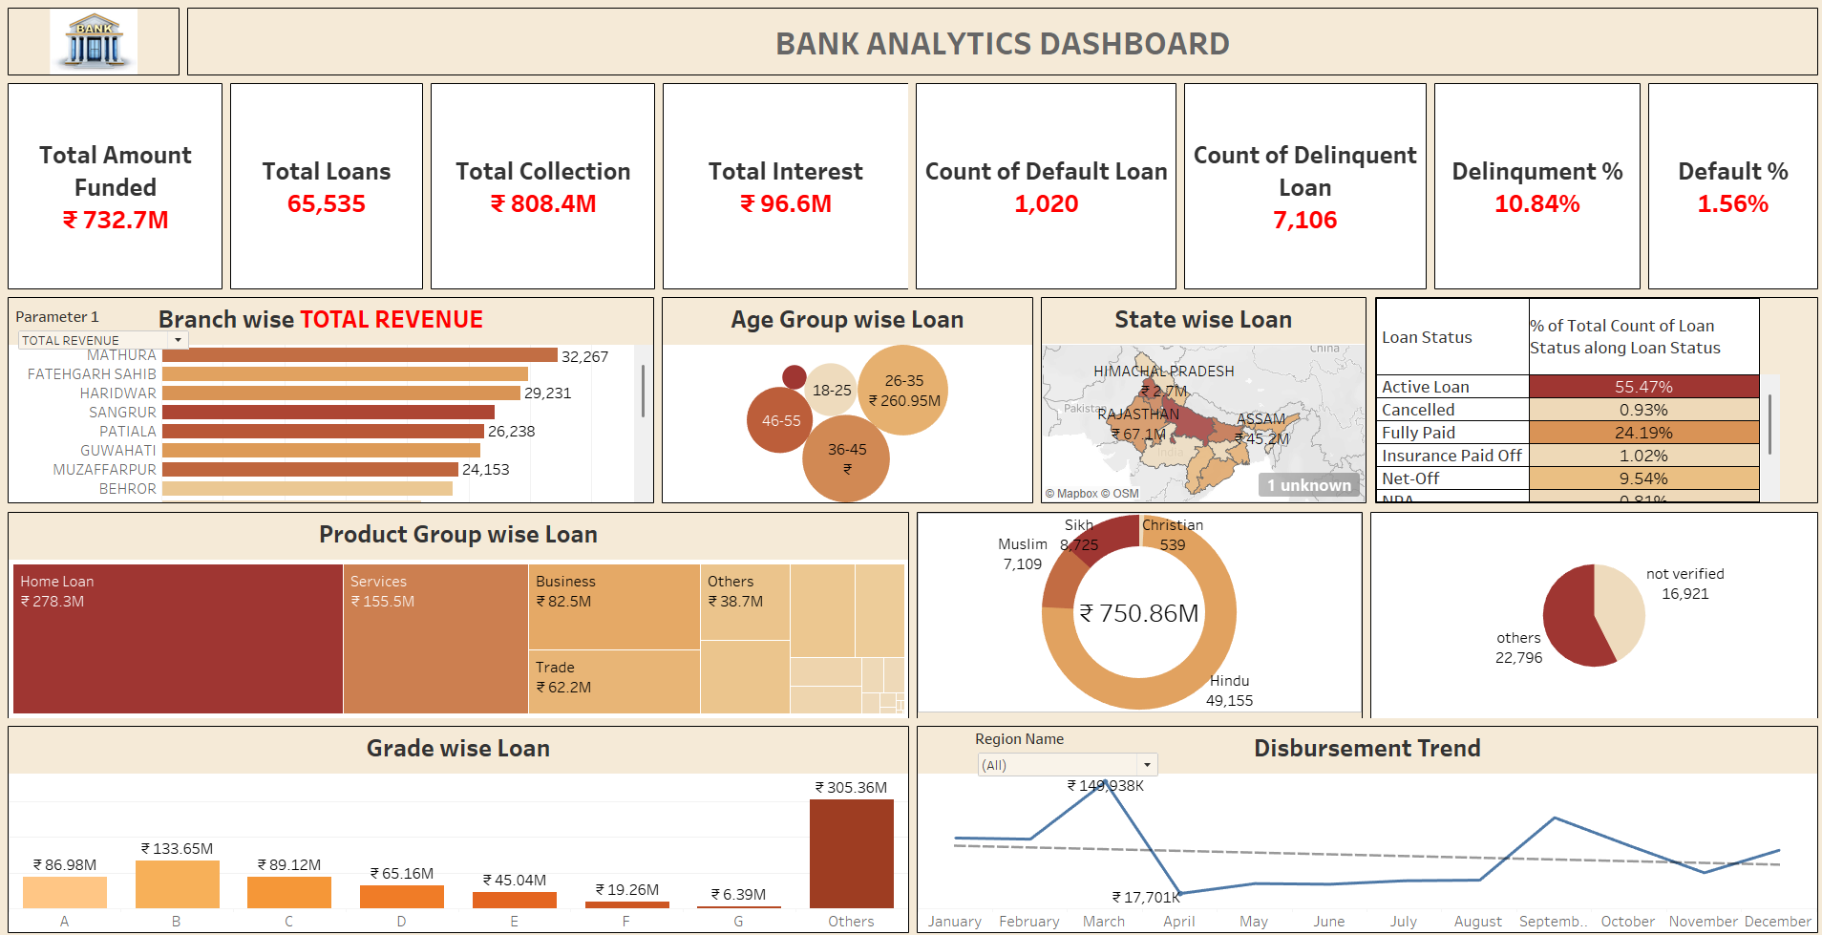
TABLEAU DASHBOARD

Slide 10
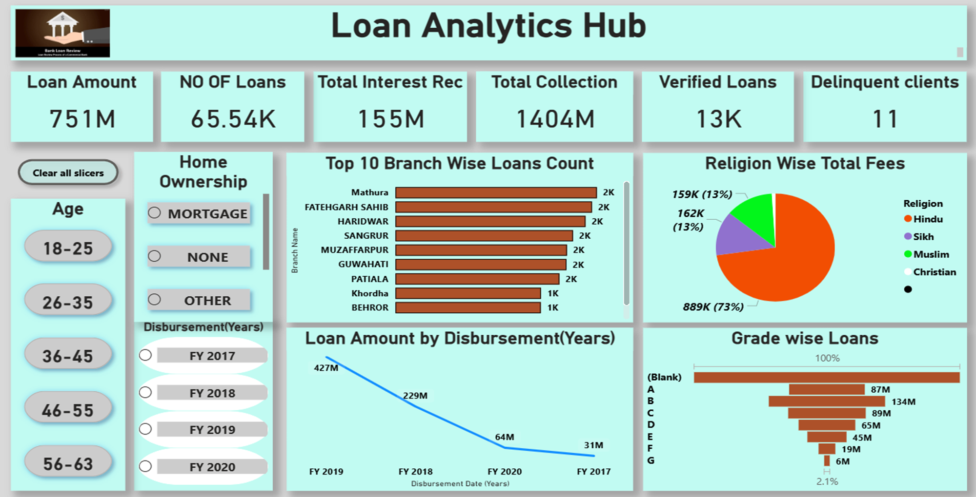
POWER BI DASHBOARD

Slide 11
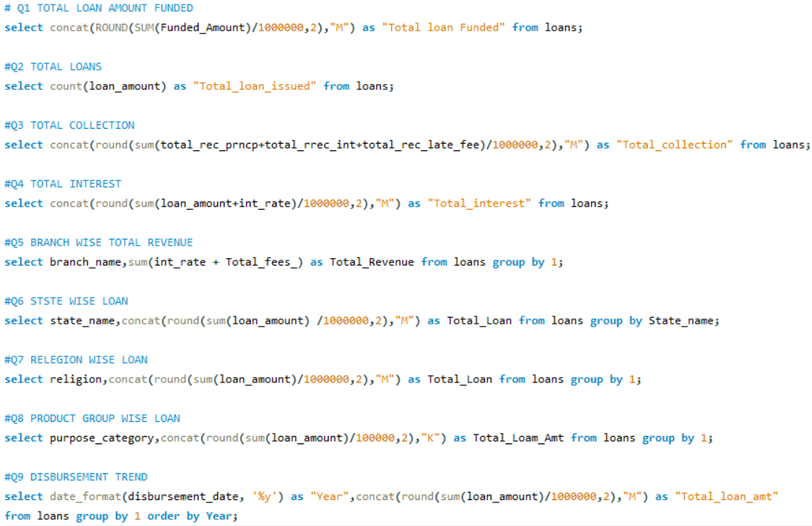
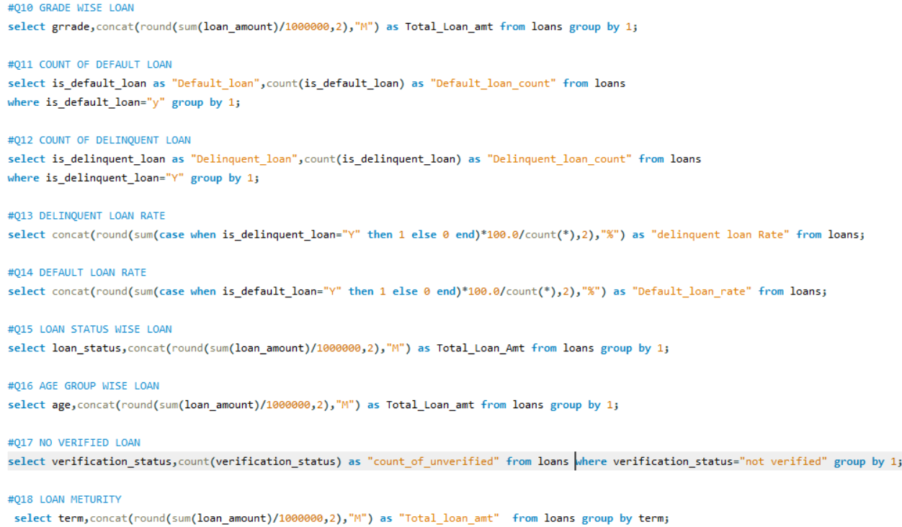
MY SQL COMMANDS

Slide 12
CREDIT AND DEBIT DASHBOARD
Key KPIs:
Total Credit Amount: ₹128 Million
Total Debit Amount: ₹127 Million
Net Transaction Amount: ₹0.32 Million (positive)
Credit to Debit Ratio: 1.0025 : 1
Account Activity Ratio: 0.0002 : 1 (very low)
📌 Insights:
Transaction Methods Distribution:
Balanced among Debit Card (34%), Credit Card (33%), and Bank Transfer (33%).
Indicates even preference by users.
Branch Performance:
City Centre Branch has the highest transaction amount (~₹42.91M).
North Branch the lowest (~₹41.68M), but all are close in range.
Suspicious Transactions:
Peak in March (236), gradual decline after.
Sharp drop in December (5)
Transactions per Month:
Fairly stable across months (around 9.2K to 9.5K), but drastic fall in December (1.1K) Transaction Volume by Bank:
Kotak Mahindra Bank and Axis Bank lead (₹42.63M and ₹42.17M).
HDFC Bank lowest with ₹41.87M – still close, but consistently lower

Slide 13
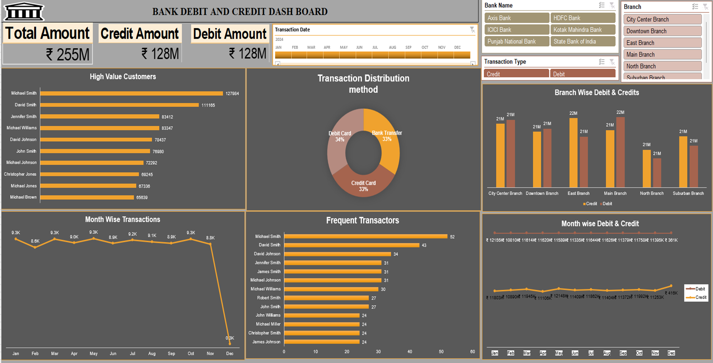
EXCEL DASHBOARD

Slide 14
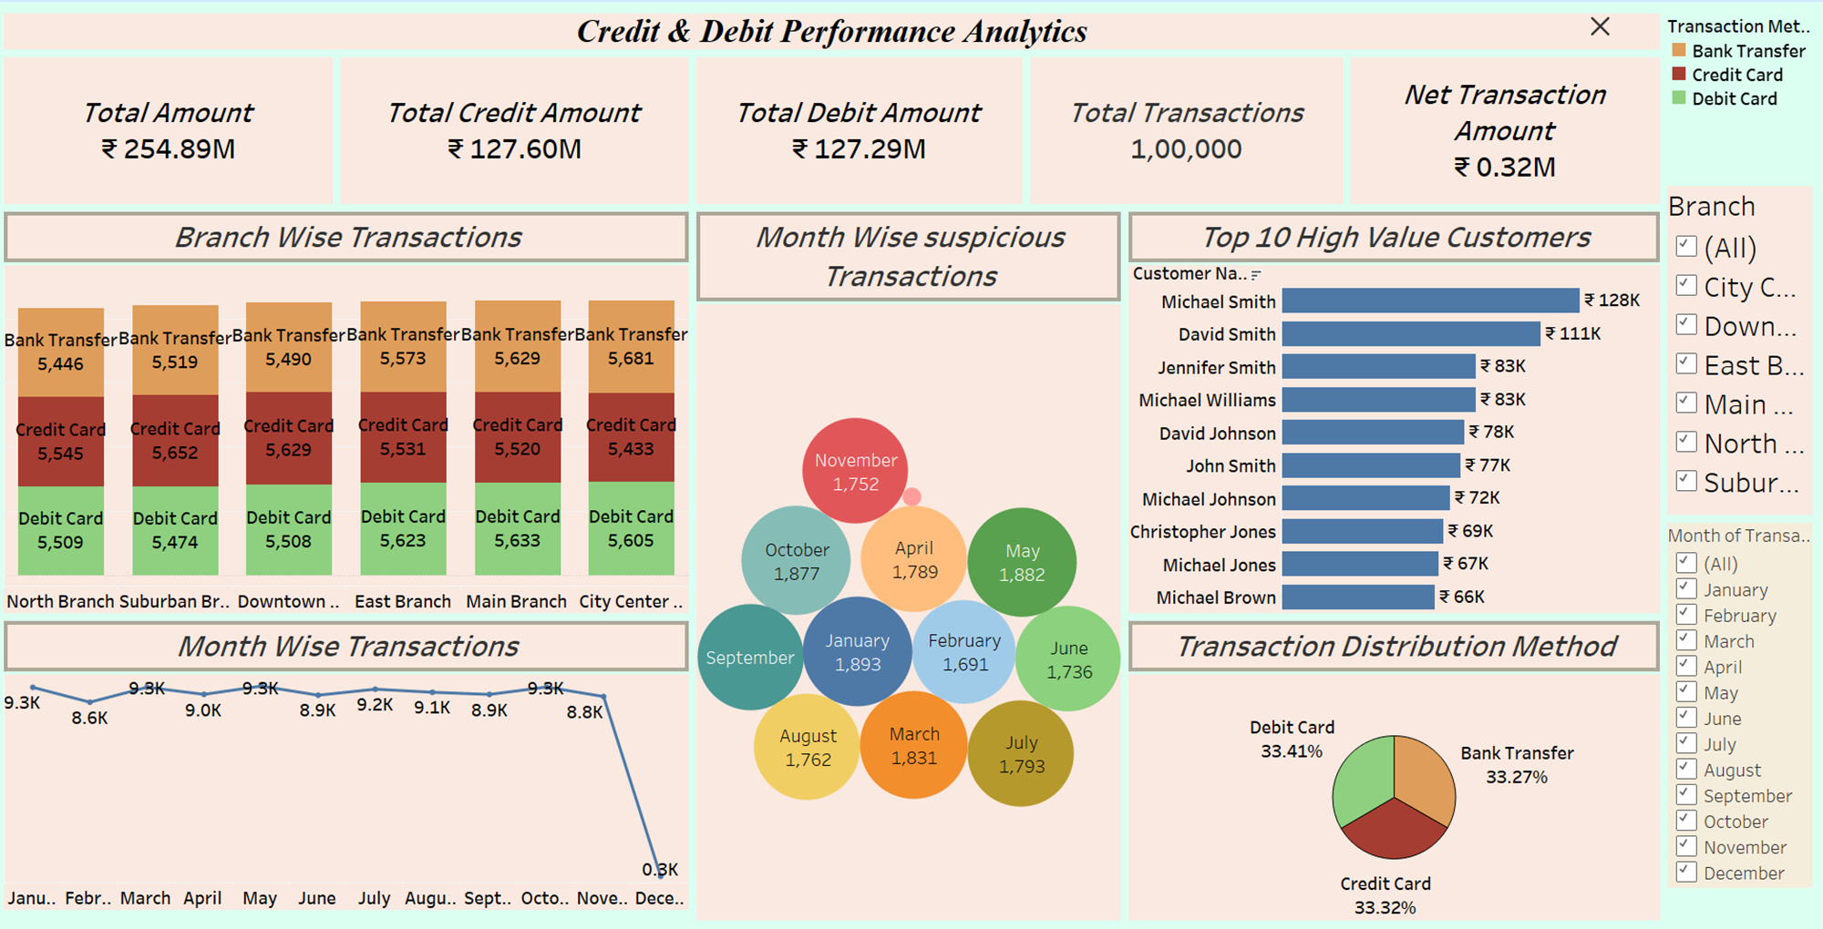
TABLEAU DASHBOARD

Slide 15
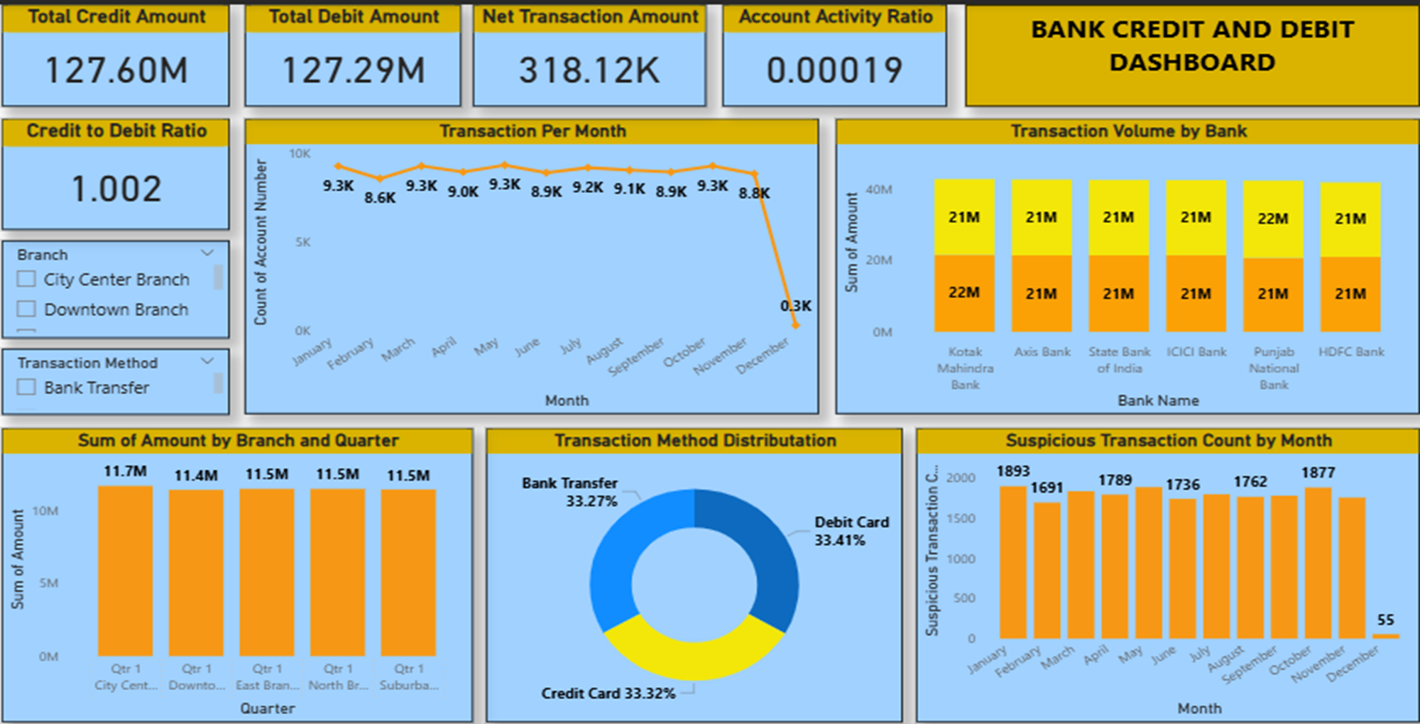
POWER BI DASHBOARD

Slide 16
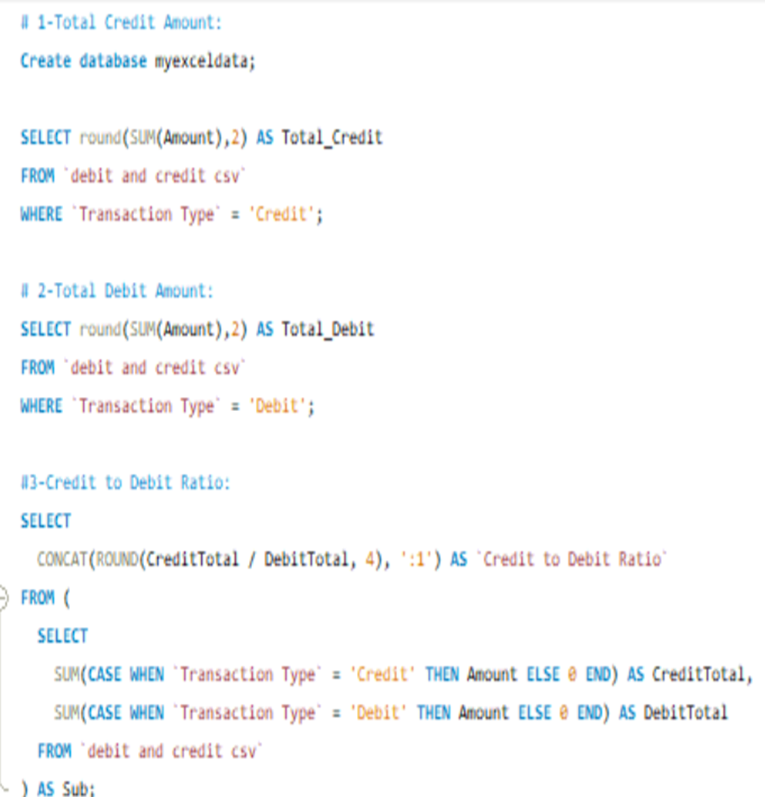
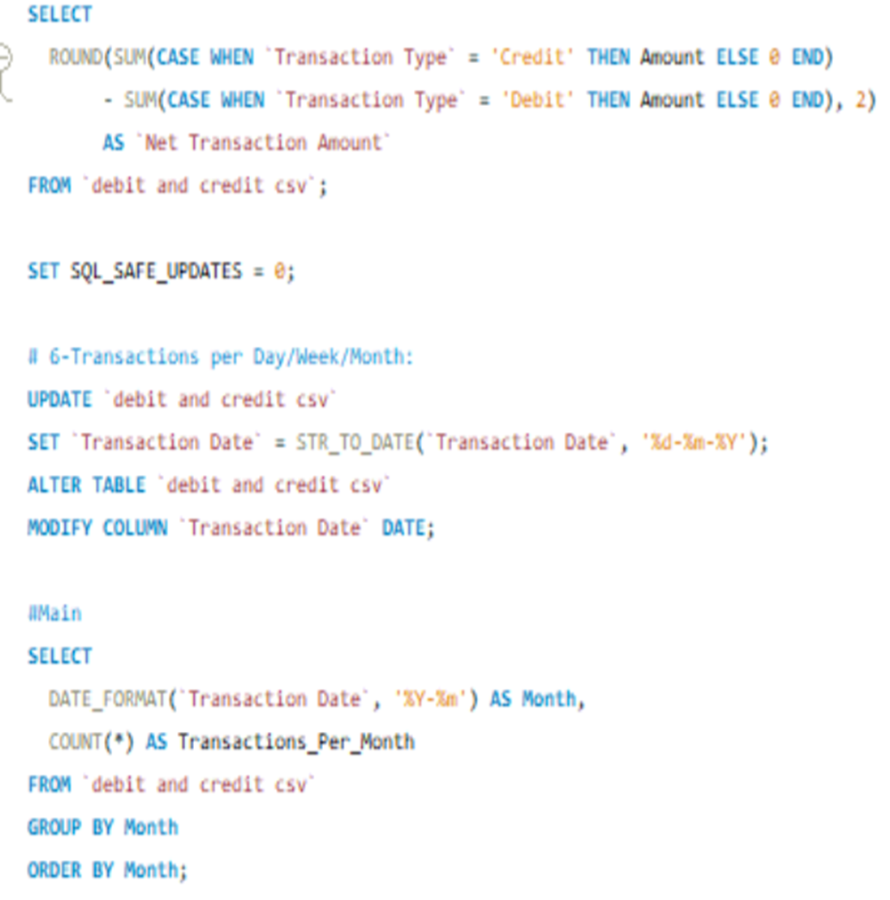
MY SQL COMMAND

Slide 17
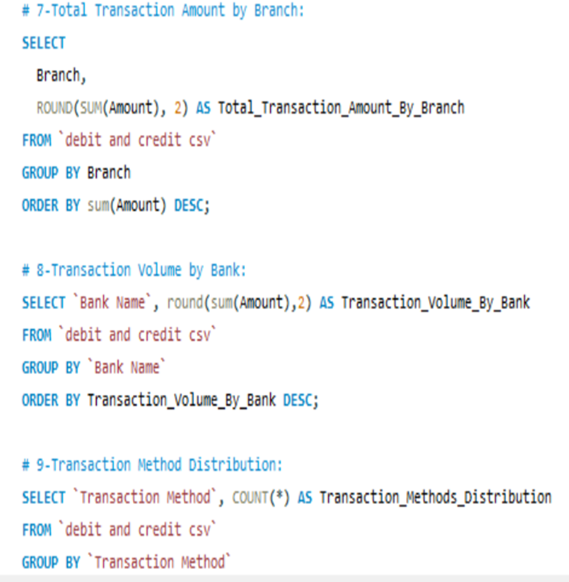
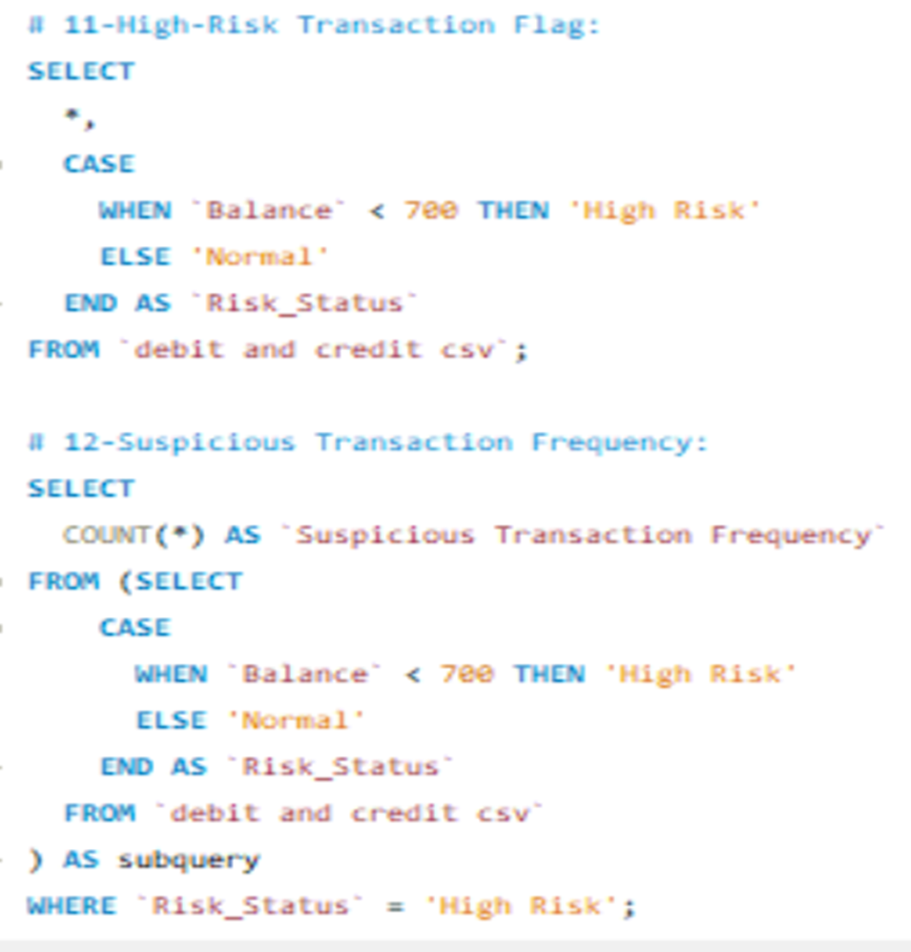

Slide 18
Strategic Recommendations
Improve Account Engagement:
Account Activity Ratio is extremely low (0.0002:1), indicating inactive or dormant accounts.
Action: Initiate customer engagement campaigns or account clean-up strategies.
Focus on Underperforming Branches:
Action: Branches like North and Suburban have slightly lower transaction volumes.
Action: Provide branch-level support, local marketing, or product training
Strengthen Risk Monitoring:
Action: Reduce delinquency (10.84%) through early-warning systems and improved borrower screening.
Target High-Performing Segments:
Focus on Home Loans and the 26–35 age group, which show high engagement and loan volume.
Action: Launch tailored offers or pre-approved loan products for these segments.
Improve Loan Verification Process:
High number of Not-Verified Loans (42.74K) poses operational risk.
Action: Strengthen KYC/verification protocols to minimize fraudulent or weak applicants.
Use Targeted Marketing Based on Region:
States like UP, Punjab, and Bihar show higher loan volumes.
Action: Focus campaigns in high-potential states and replicate best practices in lower-performing ones.

Slide 19
CONCLUSION
The Loan Analytics Dashboard provides a complete overview of the bank’s lending ecosystem, covering funding, collection, interest, and repayment trends.
It identifies profitable segments like Home Loans and the 26–35 age group, along with top-performing states such as Uttar Pradesh and Punjab.
However, it also reveals operational risks such as a high delinquent loan rate (10.84%).
Overall, the dashboard empowers better loan risk monitoring, data governance, and targeted lending strategies to strengthen financial health.
The Transaction Dashboard offers real-time visibility into cash flows, channel mix, and branch activity.
It confirms a stable, balanced credit/debit mix and consistent branch performance, yet uncovers suspicious spikes and seasonal drops.
With method distribution, monthly trends, and bank-level volumes all in one place, it empowers fraud detection and operational tuning.
In sum, this dashboard underpins continuous transaction monitoring, fraud prevention, and digital engagement initiatives.

Slide 20


